Slide 1
TRAVEL Insurance Industry Regression Analysis MGMT 5504-Group Project Aline Wah Karuna

Slide 2
What’s affect the net sale?
Problem Description:
Our company is interested in increasing profits by exploring factors that affect net sales in the Asia region. We will be conducting an analysis to identify potential areas for growth and to determine if a new product offering or changes to our marketing and operational strategies are needed.
Concepts to Measure:
Net Sales, Profit, Marketing, Operational Strategies

Slide 3
Let’s Explore our Data
01
02
Age
Duration
03
04
05
Claim
Commission
Distribution Channel
Data Source: Kaggle on a third-party travel insurance servicing company based in Singapore
Net Sales

Slide 4


Analysis
We want to find out if there is a relationship between the net sales and various factors such as age, duration, commission, distribution channel, and claim.
Assumption: Here we are assuming that there is no association between age, duration, commission, distribution channel, claim and net sales.
To find out whether Net sale affects by the various factors, we used various analysis techniques.(Multiple Linear Regression, Descriptive Statistics, Hypothesis Testing, and Correlation Matrix )

Slide 5
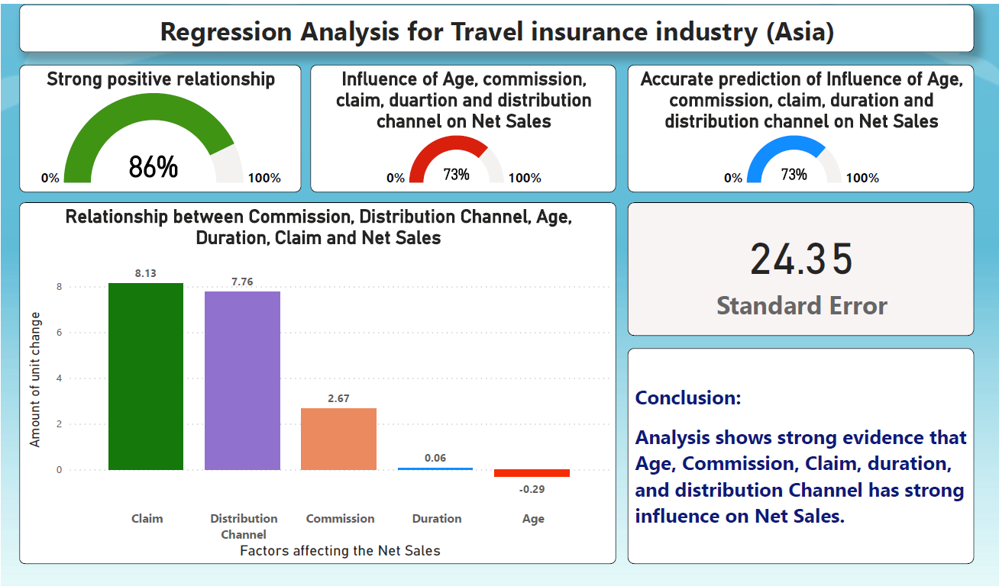

Slide 6
Recommendations
Personalized insurance plans
Improve digital presence
Customers have different needs when it comes to travel insurance. By offering customized plans that cater to their specific travel requirements, the company can increase customer satisfaction and loyal
In today's digital age, having a strong online presence is crucial. The company should invest in a user-friendly website and mobile app that allows customers to easily purchase travel insurance policies.
Notes:
Leverage data analytics
The company should leverage data analytics to understand customer behavior and preferences. This can help them tailor their marketing efforts and product offerings to better meet customer needs

Slide 7

Thanks

